Slide 1
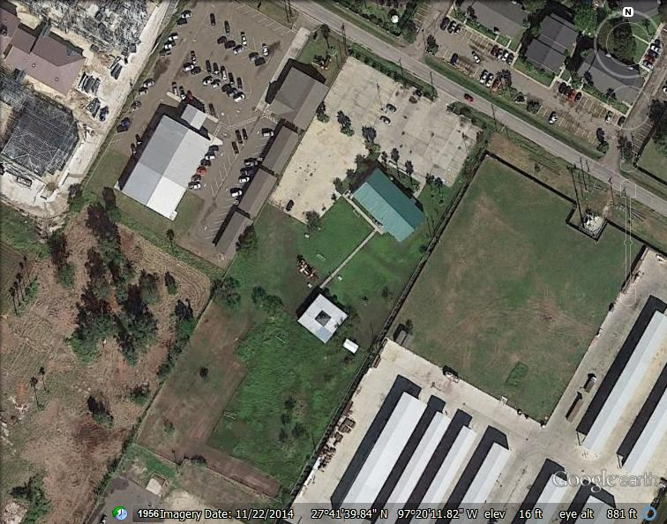
Islamic Society of South Texas
New Mosque – 10,132 square feet
7341 McArdle - Corpus Christi, Texas

Slide 2
Site Plan

Slide 3
Floor Plan

Slide 4
Comparison
Item Old Masjid New Masjid
Building Area
Total Area 5,000 sf 10,132 sf
Lobby
Width of Lobby 7’-7” 13’ – 6”
Area of Lobby 390 sf 1,225 sf
Hallway to Prayer Hall
Width of Hallway 5’-0” 6’-0”
Prayer Hall
Total Area 2,300 sf 5,200 sf
Men Area 1,533 sf 3,467 sf
Women Area 767 sf 1,733 sf
Office
Area of Office 153 sf 210 sf
Purification
Area of Purification N/A 117 sf
Item Old Masjid New Masjid
Restroom Men
Area of Restroom 198 sf 690 sf
Fixture Count
Toilets 2 5
Lavatories 1 3
Wudu 3 12
Shoe rack 19 lf 38 lf
Restroom Women
Area of Restroom 158 sf 560 sf
Fixture Count
Toilets 2 5
Lavatories 1 3
Wudu 3 8
Shoe rack 18 lf 29 lf
Classroom/Quiet/Multipupose
Number of rooms N/A 7
Total Area N/A 1,320 sf

Slide 5
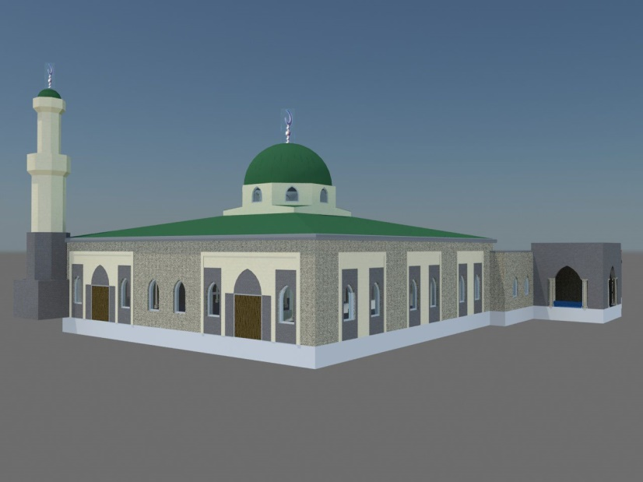
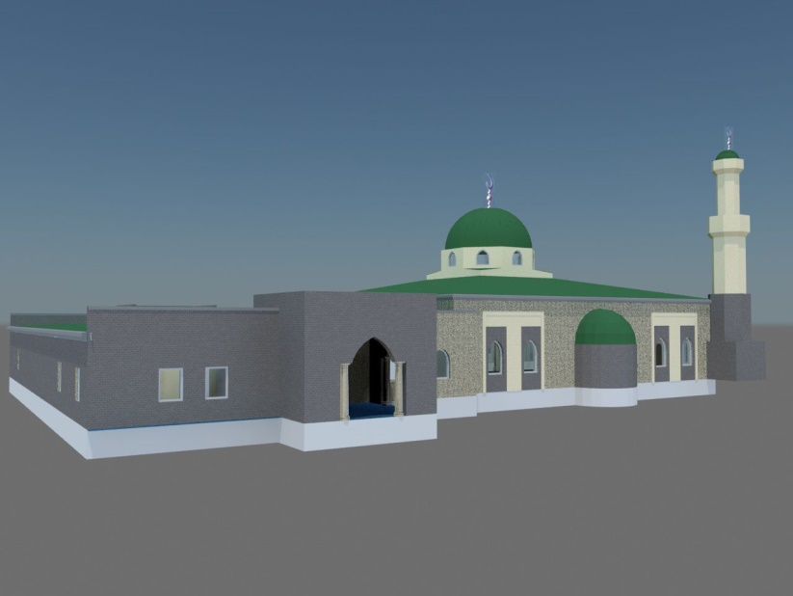
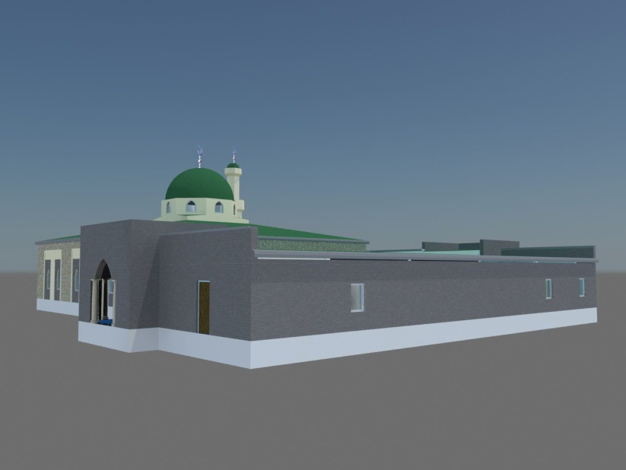
Exterior
North Elevation
West Elevation
East Elevation
South Elevation

Slide 6
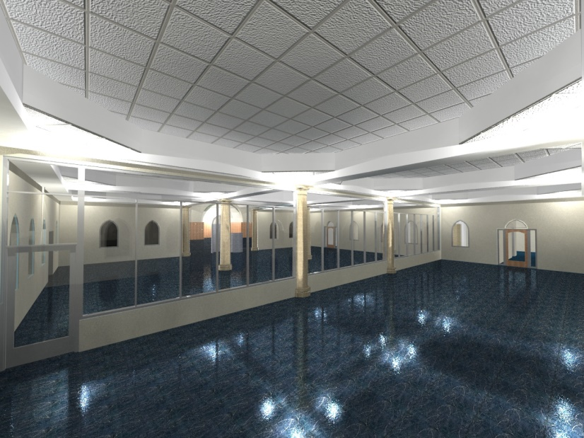
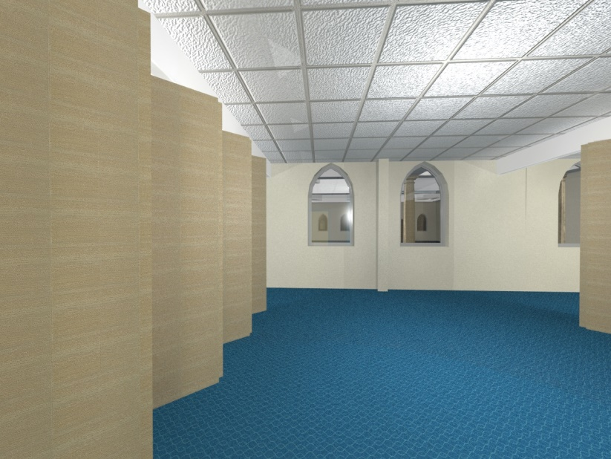
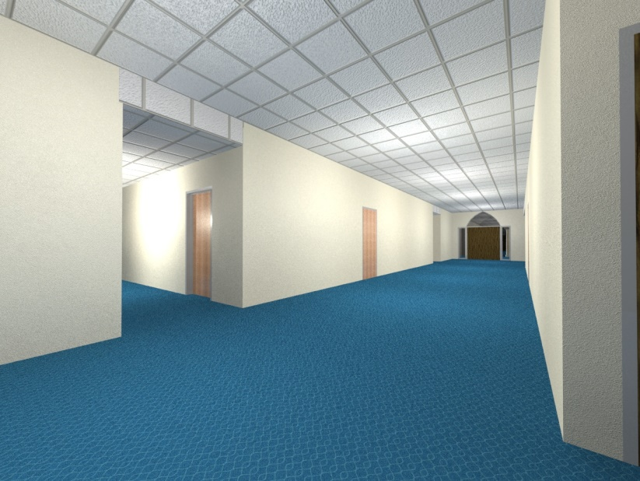
Interior
Men Prayer Hall
Women Prayer Hall
Multi-Purpose Room
Social Hall

